Slide 1
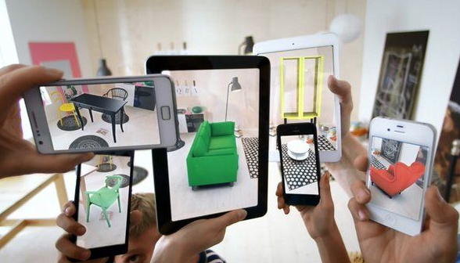
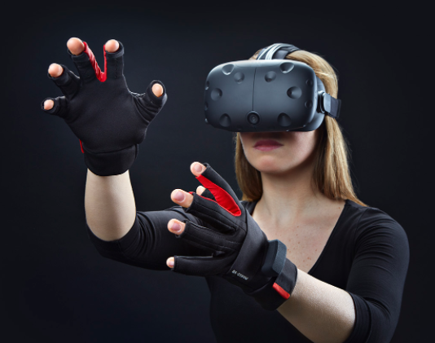
AUGMENTED REALITY
VIRTUAL REALITY M.DRUMARE

Slide 2
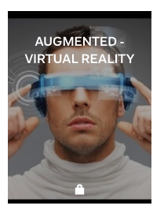
ON FLIPBOARD
http://flip.it/qMsNBj

Slide 3
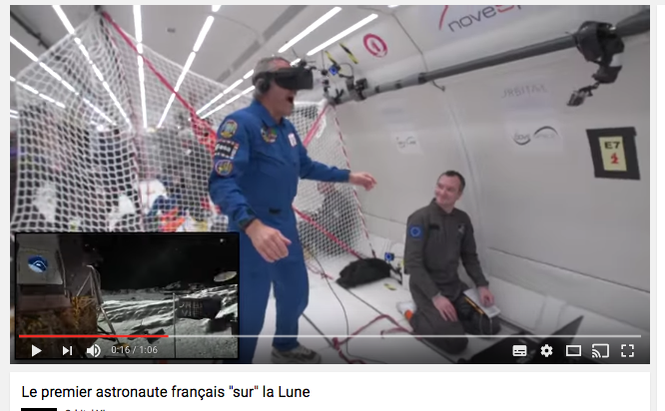
WALKING ON THE MOON

Slide 4
WHAT ?

Slide 5
Apple : Acquisitions like Primesense, Metiao, and FaceShift and a number of recent patent filings.
Samsung : Partnership with Oculus, free Gear VR (Oculus) with the pre-order of a Galaxy S7 and S7 edge.
Microsoft: Unveiled the Microsoft Hololens, a self-contained Augmented Reality headset + Xbox and Oculus partnership.
Google : Cardboard wide distribution of basic VR + Google’s Project Tango could power the next generation of mobile VR experiences + Google investment in AR with Magic Leap.
IBM : IBM’s cloud-based Watson platform, one of the most advanced artificial intelligences in the world, is beginning to power VR experiences.
Intel : Realease of a developer kit phones powered by RealSense technology and Google’s Project.
HP : The company has created a $999 VR Ready.
Foxconn: Manufacturing high performance OLED screens – the type needed for comfortable VR experiences – to Apple phones in the future.

Slide 6
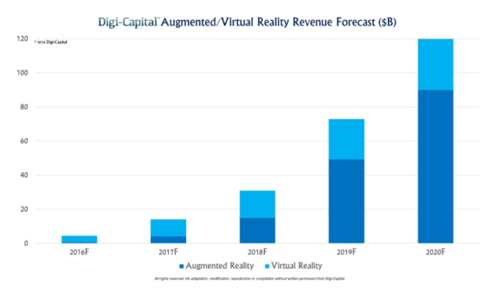
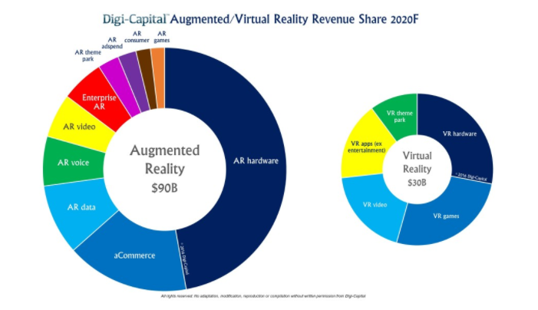
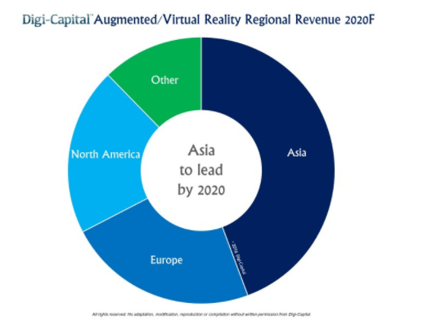
FORECAST….2020
AR forecast: $90 billion by 2020.
VR forecast : $30 billion by 2020.
AR passing VR from 2018 to 2019.
VR largely remains an entertainment market driven by hardware, games, video and theme parks, with non-entertainment apps driving a meaningful minority of revenue by 2020 as the market develops.
AR hardware revenue will drive the market, followed by augmented commerce, data, voice, video, enterprise, theme park, advertising, apps and games revenues
Asia (China, Japan, South Korea, others) could drive AR/VR revenue by 2020, followed by Europe and North America.

Slide 7
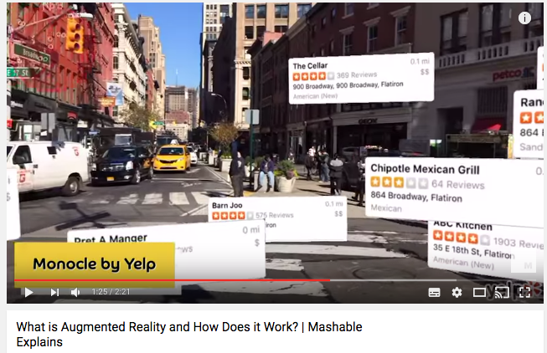
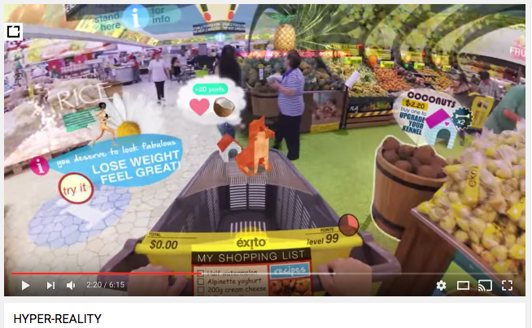
AUGMENTED REALITY
Augmented reality (AR) is a live direct or indirect view of a physical, real-world environment whose elements are augmented (or supplemented) by computer-generated sensory input such as sound, video, graphics or GPS data.

Slide 8
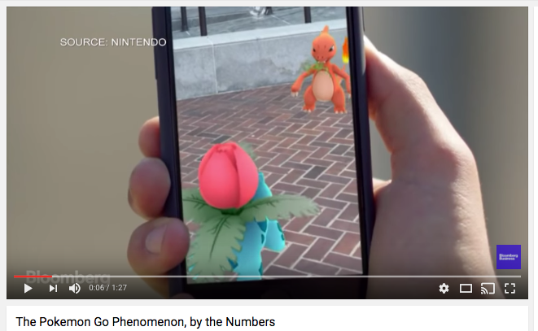
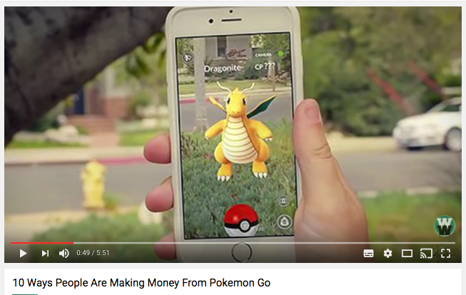
POKEMON GO PHENOMENON
Launch by Nintendo (developed by Niantic) : an augmented reality smartphone game that allows you to capture, train, and trade virtual creatures that appear in the real world. Players can roam their neighborhood to find Pokémon, throwing a virtual ball to capture them.
Just two days after its release, the game was already installed on 5.16 percent of all Android devices in the U.S.—that’s more than Tinder. It’s also nudging Twitter in terms of numbers of active U.S. users.
While virtual reality could be big soon ... augmented reality could be bigger.

Slide 9
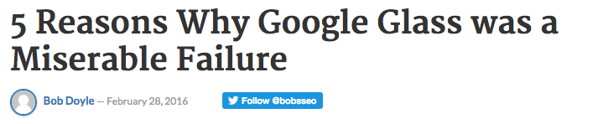


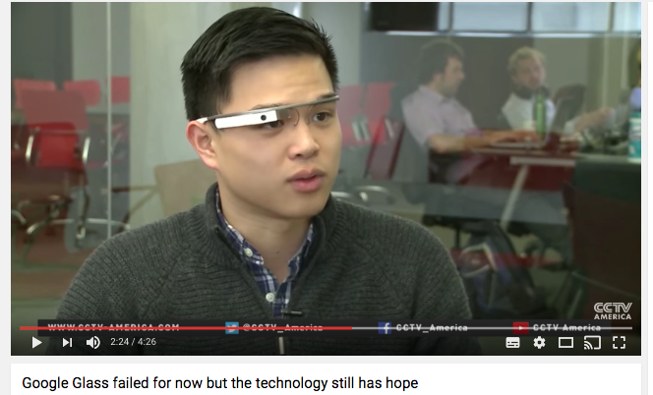
GOOGLE GLASS FAIL
$1500 Google Glass failed because it didn’t have enough utility to get over that cost. The camera really sucked. The battery life only lasted 45 minutes. The display was really small and low resolution.
No Real Product Launch : The product was launched in a novel way - give early adopters ancelebrities Google Glass. The date the product can be purchased never happened.No Mainstream Advertising.
No Easy Way To Buy It. Not initially available for purchase.

Slide 10

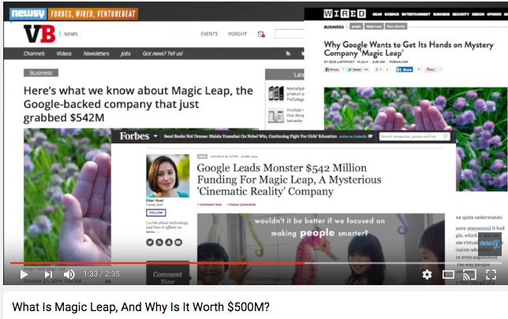
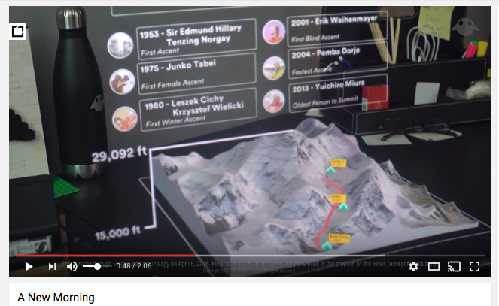
GOOGLE AR FUTURE IS MAGIC LEAP
In 2014 Google helped lead a $542M investment round in the enigmatic startup, which recently received a $4.5bn valuation despite never publicly displaying a product.

Slide 11
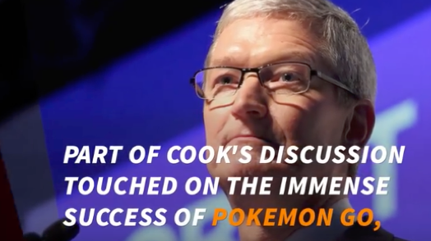
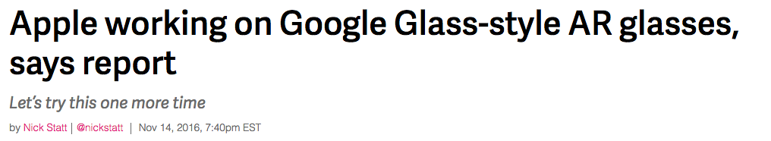
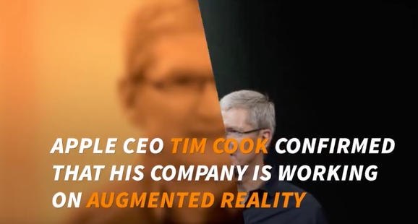
APPLE PROJECTS
Apple is rumored to have a research unit comprising hundreds of employees working on AR and VR.
Apple recently acquired augmented reality startups : Metaio, Faceshift, etc..
Smart glasses that would connect wirelessly to the iPhone like the Apple Watch?
Incorporation of its augmented reality research into its ongoing car project as part of an in-car software system?
Integration of augmented reality functionality into the iPhone's camera app, Snapchat.

Slide 12

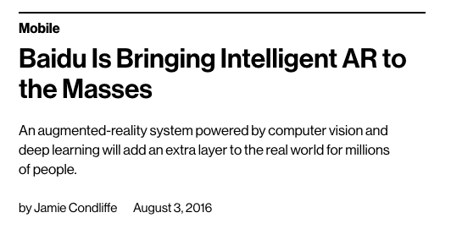
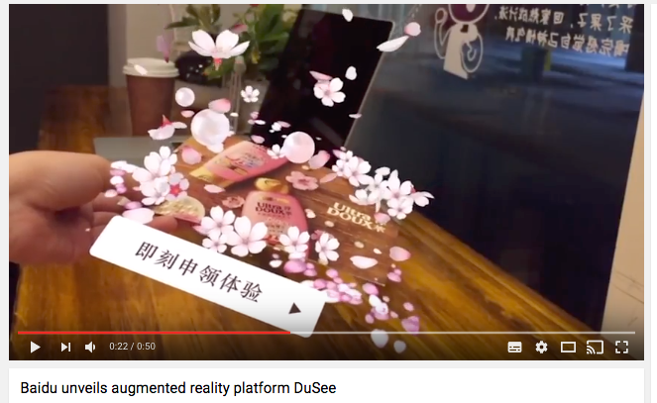
MOBILE AR : DuSee by BAIDU
August 2016, China's leading search engine announced DuSee, a new augmented reality (AR) platform developed for smartphones.
DuSee will be integrated into Baidu's flagship platform apps, such as the Mobile Baidu search app, which has a vast user base of hundreds of millions of monthly active mobile users.
DuSee is a collaboration between Baidu Research's Institute of Deep Learning (IDL) and Baidu's search products, sales and marketing teams.

Slide 13
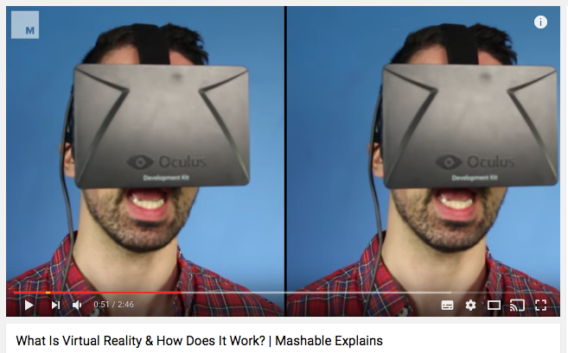
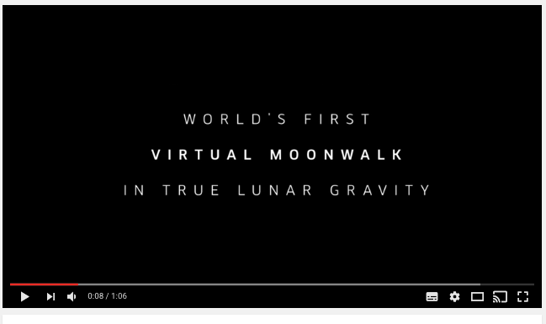
VIRTUAL REALITY
Virtual Reality (VR), sometimes referred to as immersive multimedia, is a computer-simulated environment that can simulate physical presence in places in the real world or imagined worlds. Virtual reality can recreate sensory experiences, which include virtual taste, sight, smell, sound, touch, etc..

Slide 14
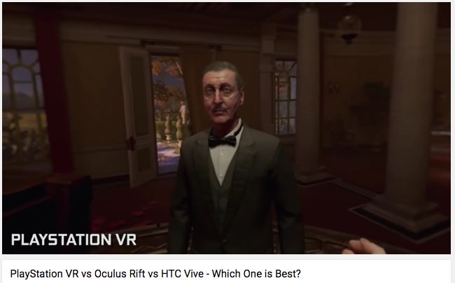
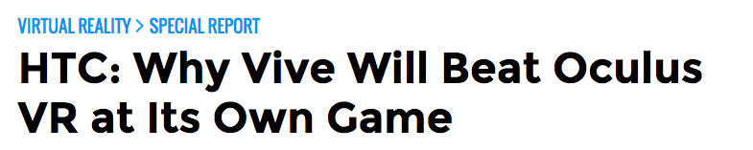

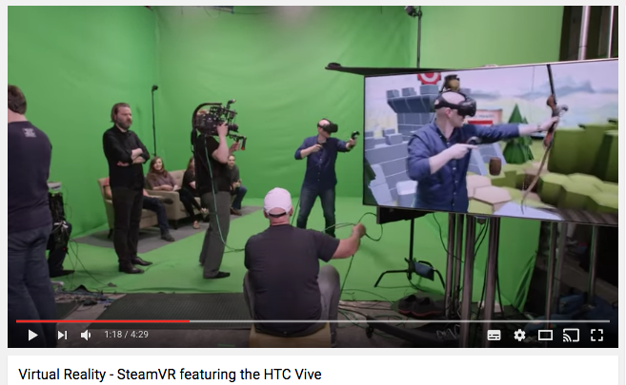
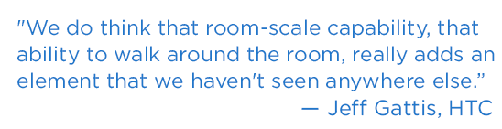
VR COMPETITION PlayStation VR vs Oculus Rift vs HTC Vive

Slide 15
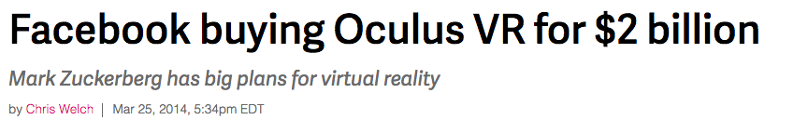
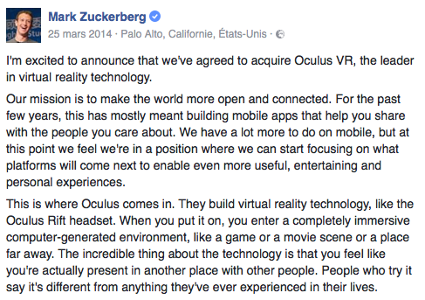
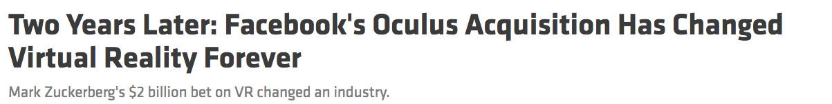
SOCIAL VR: FACEBOOK & OCULUS
« We're working on VR because I think it's the next major computing and communication platform after phones » Mark Zuckerberg.
After that [acquisition] happened in 2014, it was a signal to the rest of the industry that VR was here, this is gonna be a huge thing and if you didn’t invest in VR now you were gonna get your ass kicked down the line.
Since that deal was announced, the number of venture capital deals and total dollars invested in VR and AR have both tripled.

Slide 16
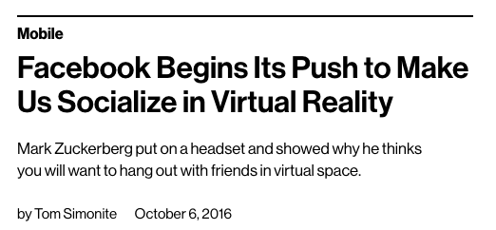
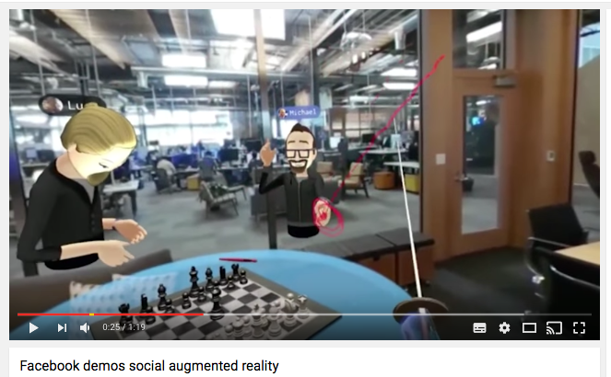
SOCIAL VR : FACEBOOK & OCULUS
October 2016. Mark Zuckerberg demonstrated a new social VR experience that overlays VR avatars of friends who are elsewhere.
Inside this social VR experience people can take real world scenes in the form of 360 photos, and visit them.
People can play games like chess or cards, sword fight with pre-made or DIY-drawn swords, or watch a giant TV screen together.
They can even take a phone call inside Facebook Messenger or take a VR selfie and instantly share it to Facebook.
They can express your emotions to friends by inputting gestural commands into Oculus Touch controllers and through recognition of when you’re talking.
Getting started with the Oculus Rift headset and controllers, on the other hand, will cost $1,600 or more thanks to the price of the gadgets and the powerful PC needed to drive them.

Slide 17
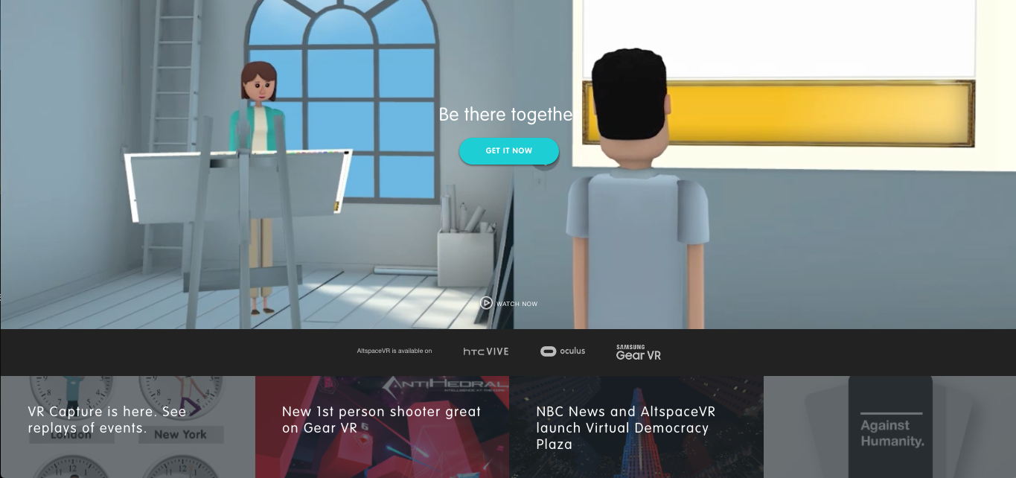
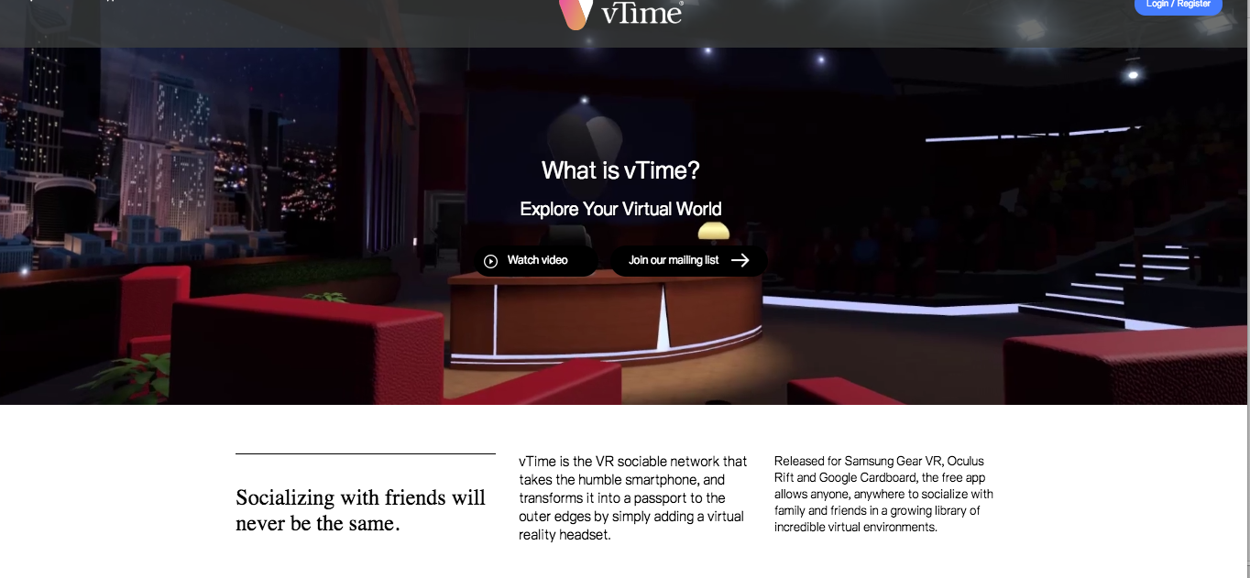
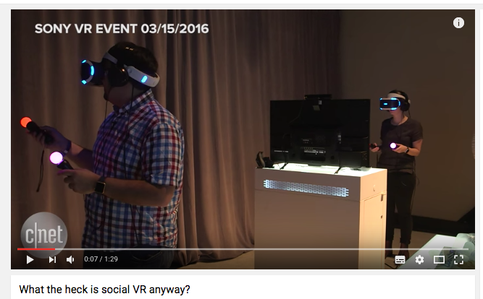
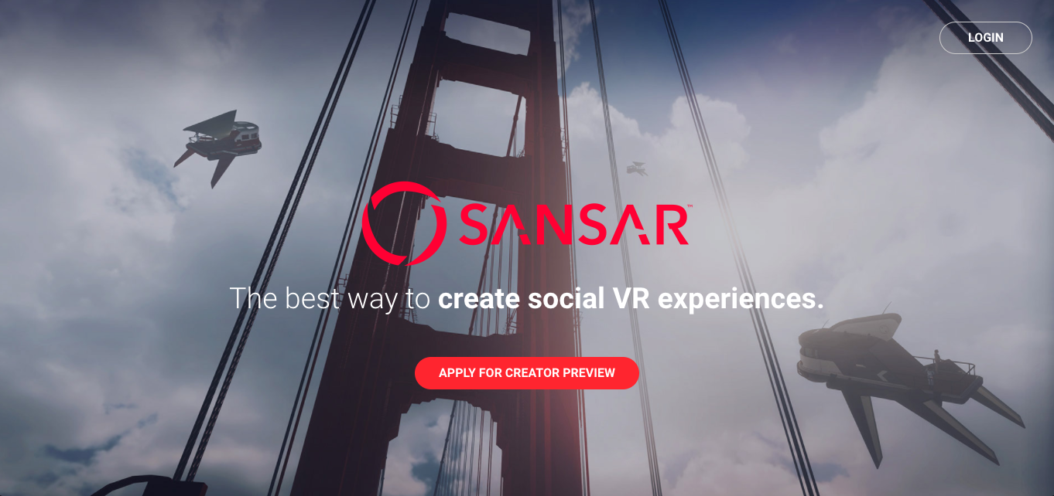
SOCIAL VR COMPETITORS

Slide 18
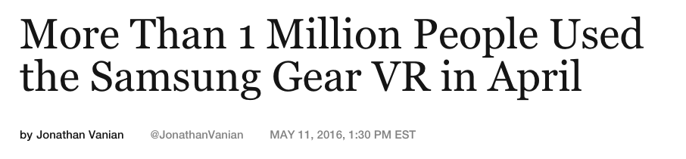
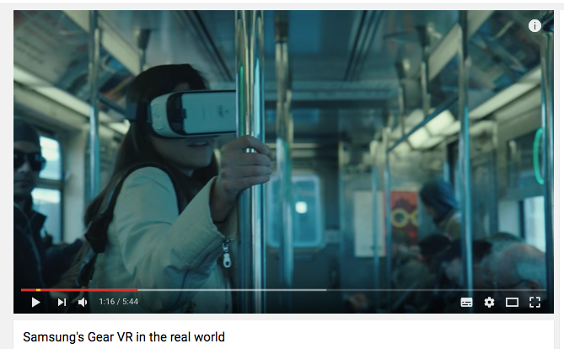
MOBILE VR : SAMSUNG GEAR VR & OCCULUS
1M People used the Samsung Gear VR in April 2016.
In comparison to the mobile device market in general, the one million-user number is relatively small. Google’s Android operating system that powers millions of smartphones worldwide, for example, counts over 1.4 billion monthly active users.
80% of people who use the Gear VR watch video on the device and that “seven of the top apps on the Gear VR are video apps.”

Slide 19
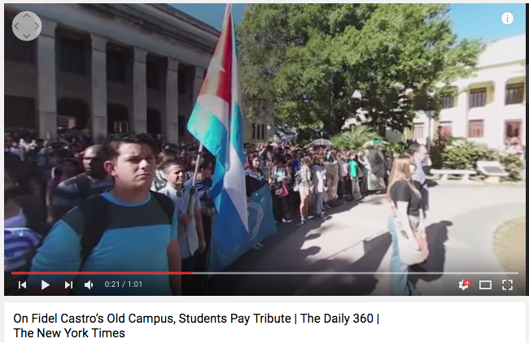
MOBILE LOW COST VR : GOOGLE CARDBOARD
Since the realease in june 2014 of the VR device: 5 million Cardboard devices have been shipped.
Users: SyFy channel, Visa, Lowe's, The New York Times, the Star Wars franchise, etc...
25 million Google Cardboard apps downloaded by users from the Google Play app store.
10 million of those downloads occurred between October and December 2015.

Slide 20
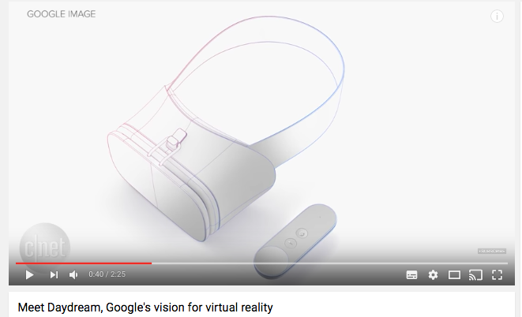
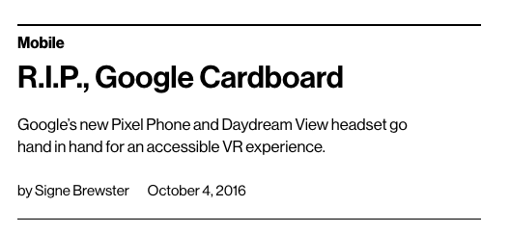
MOBILE VR ECOSYSTEM: GOOGLE DAYDREAM
October 2016, Google's new virtual-reality platform, Daydream will include VR-ready phones and a headset and controller.

Slide 21
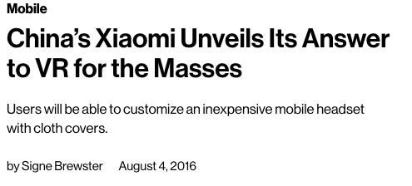
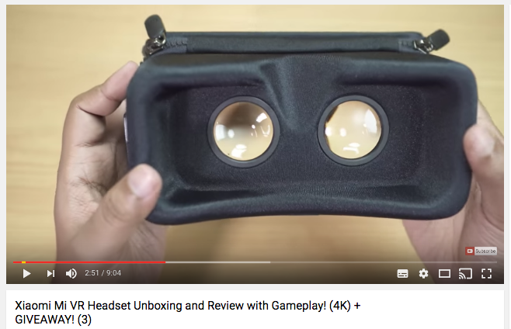
MOBILE VR : XIAOMI
Xiaomi’s phones and other Android devices are expected to be compatible with Google’s upcoming Daydream, a combination of software, sensors, and displays that will make phones specially equipped for VR.
Chinese mobile giant Xiaomi revealed the Mi VR Play: its first virtual-reality headset, and like the rest of the company’s products, it’s built to appeal to a wide audience

Slide 22
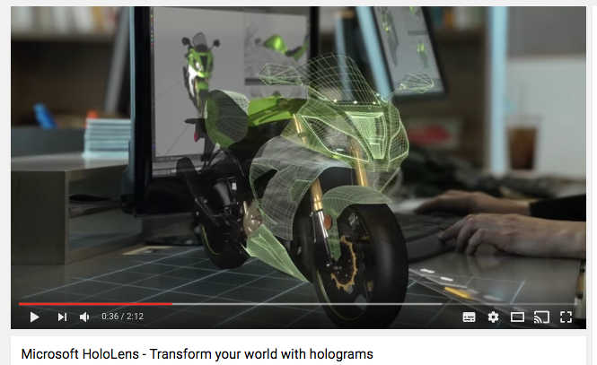

MIXED REALITY: MICROSOFT HOLOLENS
The HoloLens can created realistic three-dimensional images and place those images in the real world.

Slide 23
HOW ?

Slide 24
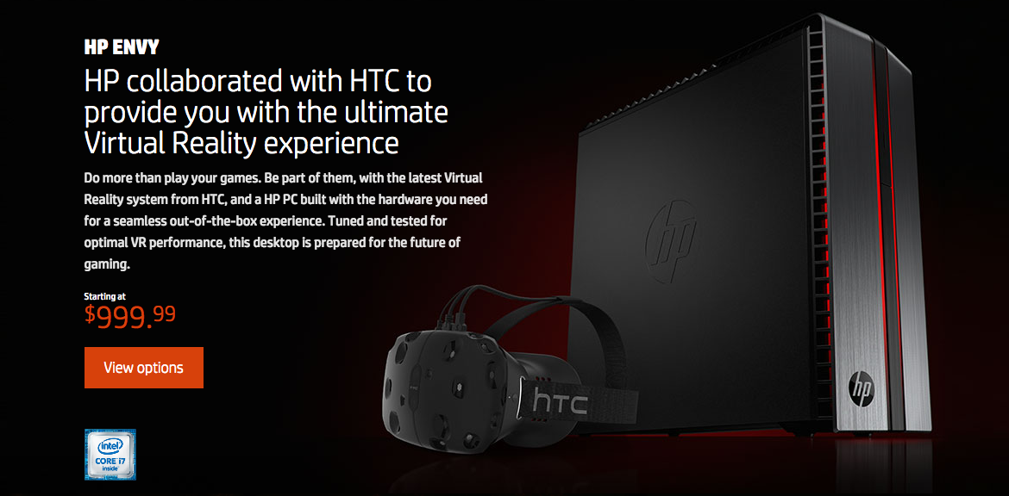
PARTNERSHIP: HP & HTC

Slide 25
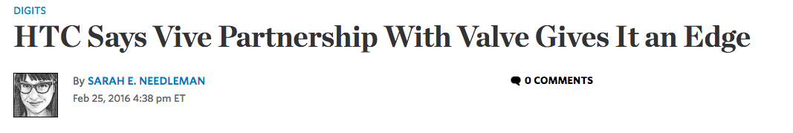
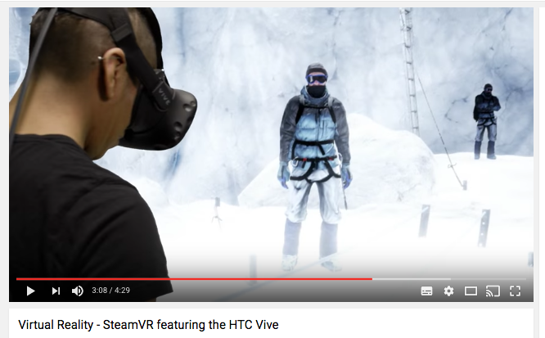
PARTNERSHIP : HTC VIVE & VALVE
In March 2015, Valve and Taiwanese electronics company HTC announced a joint project to develop the Vive, a virtual reality headset with motion tracked controllers.
The companies are working with Google, Lions Gate, HBO to develop content for the device.
The HTC Vive is the only room-scale virtual reality platform coming out. Valve and HTC are designing virtual reality experiences that take place within a predefined physical space. This allows users to walk around and explore.

Slide 26

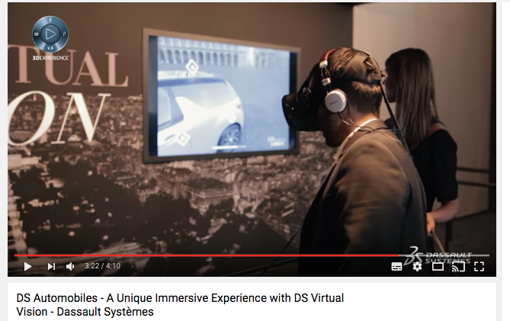
PARTNERSHIP : HTC & DASSAULT SYSTEMES
Dassault Systèmes, world leader in 3D design software, 3D Digital Mock Up and Product Lifecycle Management (PLM) solutions, has developed the 3DEXPERIENCE platform as a collaborative virtual environment for businesses.
Dassault Systèmes is leading the way in demonstrating how VR can help organizations transform their business, enhancing their products and services or creating completely new offerings.

Slide 27
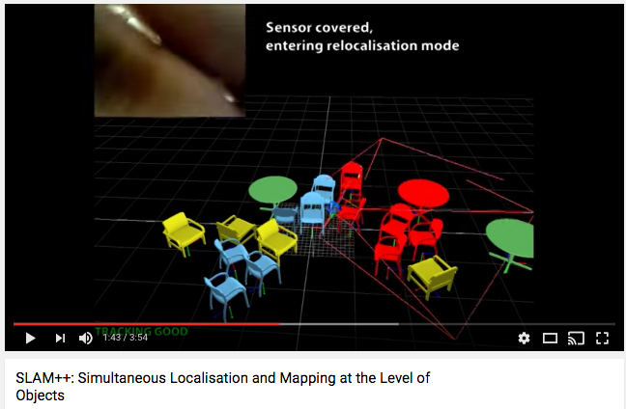
ACQUISITION : OCULUS& SURREAL VISION
Virtual reality company Oculus has acquired Surreal Vision, a UK company whose software can map and recreate the real world in a virtual one.
Surreal Vision grew out of its three co-founders' Ph.D. research at Imperial College London.
The team will now move to Oculus' lab in Redmond, Washington.

Slide 28
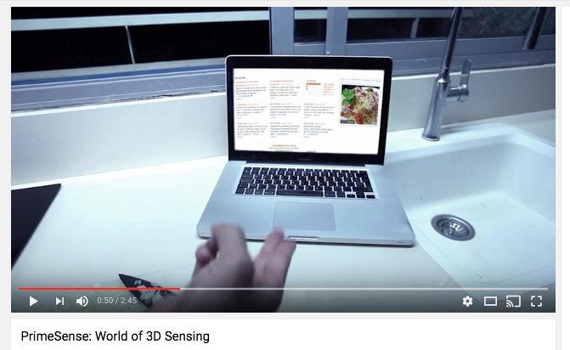
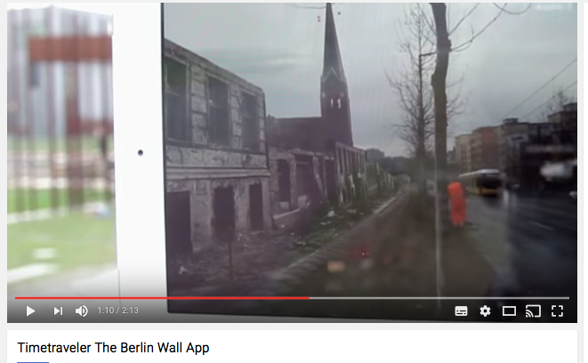



ACQUISITIONS : APPLE
Across 2015 and 2016, Apple purchased several companies that created AR/VR-related products.
Israeli-based 3D body sensing PrimeSense in 2013.
Augmented reality startup Metaio in May of 2015.
Faceshift in August of 2015.
Emotient in Juanuary of 2016.
Flyby Media in early 2016.
Apple's Secret Virtual Reality Project
http://urlz.fr/4uwb

Slide 29


EXPERTISE : APPLE
Doug Bowman who previously led the Virginia Tech's Center for Human-Computer Interaction.
Zeyu Li who served as a principal computer vision engineer at Magic Leap (a startup developing a head-mounted AR/VR display), is now working at Apple as a "Senior Computer Vision Algorithm Engineer. »
Yury Petrov a former research scientist at Facebook-owned Oculus, is now serving as a "research scientist" at Apple.

Slide 30




PATENTS: APPLE

Slide 31



INNOVATE : OCULUS TOUCH
Oculus Touch allows to be more physically engaged with a virtual environment and help the user lose himself in the experience.
More easily forget that he has a heavy gadget strapped onto his head and an LCD within a couple of inches of his eyes.

Slide 32


INNOVATE : TANGO BY GOOGLE
Technology platform that uses computer vision to enable mobile devices, such as smartphones and tablets, to detect their position relative to the world around them without using GPS or other external signals.
This allows application developers to create user experiences that include indoor navigation, 3D mapping, physical space measurement, environmental recognition, augmented reality, and windows into a virtual world.

Slide 33


SYNERGIES: GOOGLE TANGO & LENOVO
At CES, in January 2016, Google announced a partnership with Lenovo to release a consumer smartphone during the summer of 2016 to feature Tango technology marketed at consumers.

Slide 34

SYNERGIES : IBM WATSON
Virtual Reality Massive Multiplayer Online Game (VRMMO)
Virtual reality project to try and bring the fictional world of the Sword Art Online light novels and anime closer to reality.
The project uses a next-generation computing system called the “Cognitive System” that supports human decision-making, as well as “SoftLayer” IBM’s high performance cloud system that produces the ambiance of a real world.

Slide 35

SYNERGIES : TESLA?
The electric automaker has hired top industrial designer Andrew Kim who has worked on the HoloLens- the AR headset of Microsoft.
Why?
Replace the car dashboard?
Have a more minimalist design for the steering wheel?
Improve safety features by imbibing holographic and AR interfaces?
Creation of a Tesla AR headset?
Workers at the automaker's Fremont, CA, factory are already using the new Google Glass Enterprise Edition to improve the manufacturing.

Slide 36



BE PIONEER : META
$73 million in funding sin 2011.
Meron Gribetz : MIT innovator under 35.
Main rival Microsoft and Hololens.
Price the meta 2: $ 949 vs $3000 Hololens.

Slide 37




MAKE AR & VR HACKATHON

Slide 38
IMPACTS ?

Slide 39


IMPACT ON RETAIL
Google’s augmented-reality platform, Tango, is being taken up by retailers who want to help future clients to visualize what purchases would look like in their home.
2016 IKEA Catalogue app features Augmented Reality: the client can see the products in its home.

Slide 40

AR SHOPPING : MICROSOFT KINECT
Kinect can render a room, a person, and the movement of objects in 3D, allowing people to interact naturally with a system.
Kinect enabled digital sign application makes it easy for shoppers to engage with products, try them on, and purchase while also using social media for additional marketing reach.
Kinect helps to create customizable and immersive experiences.

Slide 41



AR SHOPPING: BLIPPAR.COM
Blippar.com is the world’s leading visual browser, harnessing augmented reality and image-recognition technology to bring the physical world to life through smartphones, tablets and wearables.
Top style editors from Esquire, Elle and Cosmopolitan selected their pick of the best Christmas gifts from around Covent Garden including Hackett, Sandro, Dior, Kiehl’s, Charlotte Tilbury, Clinique, The Watch Gallery, Bobbi Brown, Ted Baker and Paul Smith to provide augmented reality beauty and fashion gift guides which can be accessed through the Blippar app.

Slide 42


AR SHOPPING : ALIBABA AR GAME
Alibaba is trying to create a "Pokemon Go" style augmented reality game that will drive online traffic to offline locations.
Alibaba wants its version of Pokémon GO to "become the most popular mobile game ever released." Companies such as KFC and Starbucks are spearheading this effort with Alibaba.

Slide 43


VR SHOPPING : ALIBABA & MACY
A Chinese shopper put on a VR headset, and the next thing he knew he was in Times Square in New York City.
He then took a yellow cab to Macy's department store, and was greeted by sales personnel on the floor.
From there, he strolled around the store and bought a handbag for his girlfriend.
Buy+ is integrated with Alipay. With a nod, he made a payment without the need to remove the headset to check out.
For retailers who do not have a brick-and-mortar presence in China, such as Macy's, this could be a game changer, and a dream come true.

Slide 44






EMERGENCE OF MIXED COMMERCE
A new retail format where physical merchandise is replaced by 3D models that can be configured into scenes or viewed and interacted with on their own.
Actual retail space is utilized to provide tactile engagement, allowing customers to actually interact with physical materials, along with mobile design tools.
This new model blends the best of brick and mortar with leading edge digital technologies to create a high speed and ultra efficient sales process.

Slide 45


IMPACT ON MARKETING
Coca-Cola, and their agency Big Fish, teamed up with ​AugRay ​to launch their first augmented reality event in India called "Share More Happiness".
From 24-29 Dec, 201​4​ with an interactive and fun holiday experience.
Reaching over 10,000 shoppers, selling over 2,100 Coca-Colas at one location, and generating over 2,250 AugRay interactions this campaign was the largest event of its kind in India.
Every year Coca-Cola organizes a holiday road-show, during which the Christmas cavalcade visits over 50 cities in Poland, offering a program full of attractions.
Using Oculus Rift, thousands of people all over Poland will get immersed in a virtual world and become Santa Claus, whose magical sleigh suddenly takes off.

Slide 46


IMPACT ON MARKETING

Slide 47

IMPACT ON THE SUPPLY CHAIN
Warehouse picker getting directions on his smart glasses.
Enabling real-time access to data for factory workers.

Slide 48

IMPACT ON MANUFACTURING & DESIGN
The Airbus Innovation Centre in Hamburg has developed 3D technology to apply virtual reality to cabin design.
Airbus has taken the best ideas from the gaming industry, film, and its own software engineers to transform interior cabin design creation.

Slide 49

IMPACT ON THE MANUFACTURING WORK
Ford virtual manufacturing experts focus on two key areas – design feasibility and the safety of employees on the production line.
Virtual Reality Improves Ergonomics at Ford.

Slide 50

IMPACT ON MANUFACTURING COLLABORATION
Microsoft HoloLens and Autodesk Fusion 360 are helping improve collaboration across the product development process.
Enabling engineers and designers to iterate together in real-time.

Slide 51


IMPACT ON MANUFACTURING WORK
In September 2016, Keolis Commuter Services (KCS), which operates the Greater Boston commuter rail system gave AR smart glasses to field mechanics.
They can communicate with expert technicians in its main maintenance facility.
The aim is to speed up train repairs and reduce the disruptions they cause.

Slide 52


IMPACT ON COLLABORATIVE WORK
Microsoft is working on a new project that would transform the way we video chat with people.
Microsoft Research's new augmented reality system called Room2Room projects a person into a room hologram-style, so that they appear to be sitting in a chair across from the person with who, they're speaking.

Slide 53


IMPACT ON BUILDING CONSTRUCTION

Slide 54


IMPACT ON DEFENSE

Slide 55


IMPACT ON EDUCATION

Slide 56

IMPACT ON EDUCATION
zSpace Inc. (zspace.com), a leading-edge technology company launched its all-in-one desktop virtual reality solution for education.
zSpace for Education is a streamlined hardware and software solution that allows students to manipulate virtual, 3D objects ranging from human hearts to helicopters to learn concepts such as math, physics, engineering and biology.

Slide 57



IMPACT ON HEALTH
Brennan Spiegel who directs health services research at Cedars-Sinai, says researchers found that 20 minutes with the virtual-reality software reduced patients’ pain by 24 percent on average.
Before using VR the patients had a mean pain score of roughly 5.5 on a zero to 10 scale, he says, and afterward it averaged 4.

Slide 58





IMPACT ON ENTERTAINMENT & CONTENT

Slide 59

WALKING ON MARCH

